Slide 1


Slide 2
CEREBRAL PALSY
Dr.Nosheen Iftikhar
MBBS,FCPS
Associate Professor Paediatrics

Slide 3
DEFINITION
Cerebral Palsy is defined as a non-progressive, permanent disorder of posture & movement.
It is a Static Encephalopathy.
It is a disorder involving the motor areas, which result from events before birth or during the first year of life when the brain is immature.

Slide 4
INCIDENCE
Incidence of Cerebral Palsy is about 7 in 1000 live births.
Prevalence is about 500 cases per 100,000 population

Slide 5
ETIOLOGY
No definite etiologic diagnosis in < 50% cases
Brain Insult may occur Prenatally, Perinatally or Postnatally
Less than 10% of children with CP have evidence of Intrapartum Asphyxia
Lower the birth weight, higher the incidence of CP
Premature infants with intraventricular hemorrhage are at the greatest risk of developing CP

Slide 6
ETIOLOGY (Cont;)
Main Etiological Factors can be classified according to the time they occur;
INTRAUTERINE
PERI – NATAL & POST – NATAL
INFANCY

Slide 7
ETIOLOGY (Cont;)
INTRAUTERINE:
  Bleeding
  Infections e.g., Rubella & Toxoplasmosis
  Thrombo – Embolic Phenomenon
  Congenital Malformations
  Massive Irradiation

Slide 8
ETIOLOGY (Cont;)
PERI – NATAL & POST – NATAL:
  Birth Trauma
  Intracerebral Hemorrhage
  Cerebral Infarction
  Birth Asphyxia
  Hypoxic Ischemic Encephalopathy
  Hypoglycemia
  Kernicteris
  Acidosis

Slide 9
ETIOLOGY (Cont;)
INFANCY:
  Meningitis
  Encephalitis
  Trauma
  Vascular Accidents

Slide 10
PATHOLOGY
There is widespread cerebral atrophy with cavity formation in sub – cortical White Matter.
There is atrophy of Basal Ganglia when rigidity & extrapyramidal movements are present.
There is atrophy & gliosis of cerebral hemisphere resulting in hemiplegia of the opposite side.

Slide 11
CLASSIFICATION
Classification is based on predominant Motor Deficit;
Spastic Forms
Extrapyramidal Forms
Atonic / Ataxic Cerebral Palsy
Mixed form of Cerebral Palsy

Slide 12
CLASSIFICATION
  SPASTIC FORMS:
  Includes about 75% Cases
    Quadriplegia
    Triplegia
    Diplegia
    Hemiplegia
    Monoplegia

Slide 13
QUADRIPLEGIA
    Four Extremities are equally involved
    Most severe form of CP
    Associated with Low Birth Weight & Severe Asphyxial Insults
    Common association with Seizures & Mental Retardation
    Swallowing difficulties are also associated
    Spasticity of all four limbs with;
      Decreased Spontaneous Movements
      Brisk Tendon Reflexes
      +ve Babinski Sign
      Flexion Contractures of Elbows & Knees
      Speech & Visual abnormalities are common

Slide 14
  TRIPLEGIA:
  Not common
  Three extremities are involved
MONOPLEGIA:
  Only one extremity is involved

Slide 15
DIPLEGIA:
Legs are involved more than Arms
  Excessive Adduction of the Hips in severe forms
  (A Scissoring Posture of the Lower Limbs)
  Brisk Tendon Reflexes, +ve Babinski Sign & Ankle Clonus
  Walking is delayed
  Child walks on Tiptoes
  Disuse Atrophy of Lower Limbs
  Normal Intellectual Development
  Learning Disabilities & Language Problems are present
  Chances to develop Seizures are minimal
  Most patients were born Premature with Low Birth Weight
  Becoming the most common type as more Premature Babies now survive

Slide 16
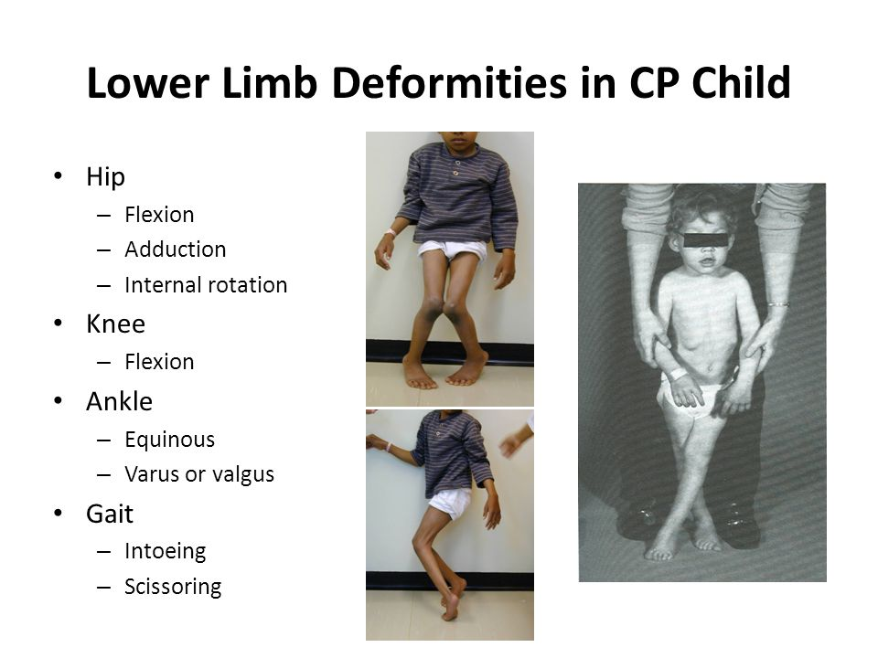

Slide 17
HEMIPLEGIA
  Decreased spontaneous movements on the affected side
  Show “Hand – Preference” at an early age
  Arm often more involved than leg
  Difficulty in hand movement is apparent by 1 year
  Walking may be delayed until 18 – 24 months
  Growth Arrest of the affected Limbs
  Affected extremities are Spastic
  Child walks on Tiptoes
  Brisk Deep Tendon Reflexes, +ve Babinski Sign & Ankle Clonus

Slide 18
2) EXTRAPYRAMIDAL FORM:
  Close association with Kernicterus
  As Kernicterus less common now, most common cause is Hypoxic – Ischemic Injury
  Comprises 20% of all CP patients
  Two forms;
    CHOREOATHETOSIS
    DYSTONIA

Slide 19
CHOREOATHETOSIS:
  Irregular, involuntary movements
  Infants are Hypotonic having Poor Head Control & Marked Head Lag
  Feeding difficulties, Tongue thrust & Drooling
  Athetoid movements usually become Evident after One year of age
  Speech is typically affected
  Seizures are uncommon
  Hearing Impairment is very common

Slide 20
DYSTONIA:
  Involuntary, Slow, Twisting movements, primarily involving Proximal Muscles of the Extremities, Trunk & Neck
  May be prominent feature of children with Extrapyramidal CP, having Basal Ganglia injury from Asphyxia, Kernicterus or insults from Metabolic Disorders

Slide 21
3) ATONIC / ATAXIC CEREBRAL PALSY:
  ATONIC DIPLEGIA:
  Associated with;
    Marked Hypotonia
    Brisk Reflexes
    Severe Cognitive Delays
  CONGENITAL CEREBELLAR ATAXIA:
    Incoordination & Intention tremors
    Hydrocephalus often is there in Ataxic – Spastic disorders

Slide 22
CLASSIFICATION
4) MIXED FORM OF CEREBRAL PALSY:
  Mixed disorders incorporating feature of different types
  Due to combinations of insults to multiple cerebral areas
  Associated with more complications;
    Sensory Deficits
    Seizures
    Cognitive & Perceptual Impairment

Slide 23
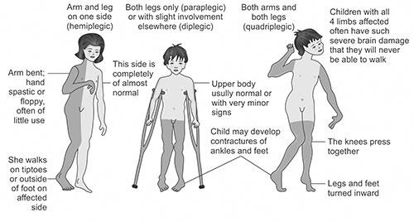

Slide 24
ASSOCIATED DEFICITS
  Seizures
    60 % of Children with Cerebral Disorders
    33 % of Children with Movement Disorders
  Mental Retardation
    Present in 25 – 50 % cases of CP
  Sensory & Speech Deficits
    Impairment of Speech, Vision, Hearing & Perceptual functions is present in varying degrees & combinations

Slide 25
CLINICAL FEATURES
Though brain lesion is fixed & non – progressive, the disorder it causes varies in the early years as different movement patterns are acquired
An affected infant is often Floppy & Hypotonic up to 6 months of age & then becomes Hypertonic
Neonatal reflexes persist beyond their normal age limit; e.g.,
  Moro reflex persists beyond the age of 3 months
  Stepping Reflex more than 6 weeks

Slide 26
Poverty of movement & facial expression
Extended or Crossed legs when the infant is suspended from the armpits
Marked adductor spasm resulting in Crossing of legs & Scissoring of gate
Exaggerated deep reflexes
Persistently Clenched Hand with Thumb adducted after 1st three months

Slide 27
Typical spastic child exhibits muscular hyper – tonocity of Clasp Knife type, eventually end in Contractures
Athetosis becomes obvious after the age of Two years
Microcephaly present in about 25% of Spastic Quadri & Diplegics
Delay in speech and high tone deafness

Slide 28
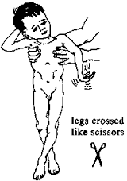

Slide 29
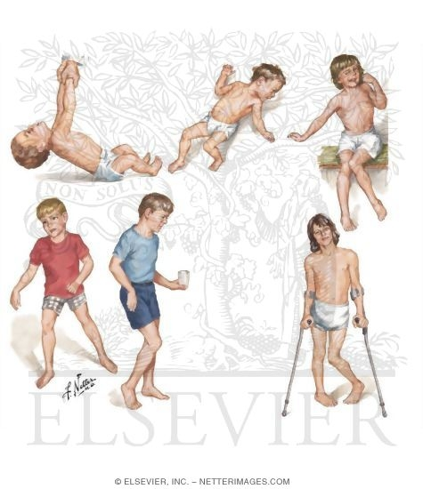

Slide 30
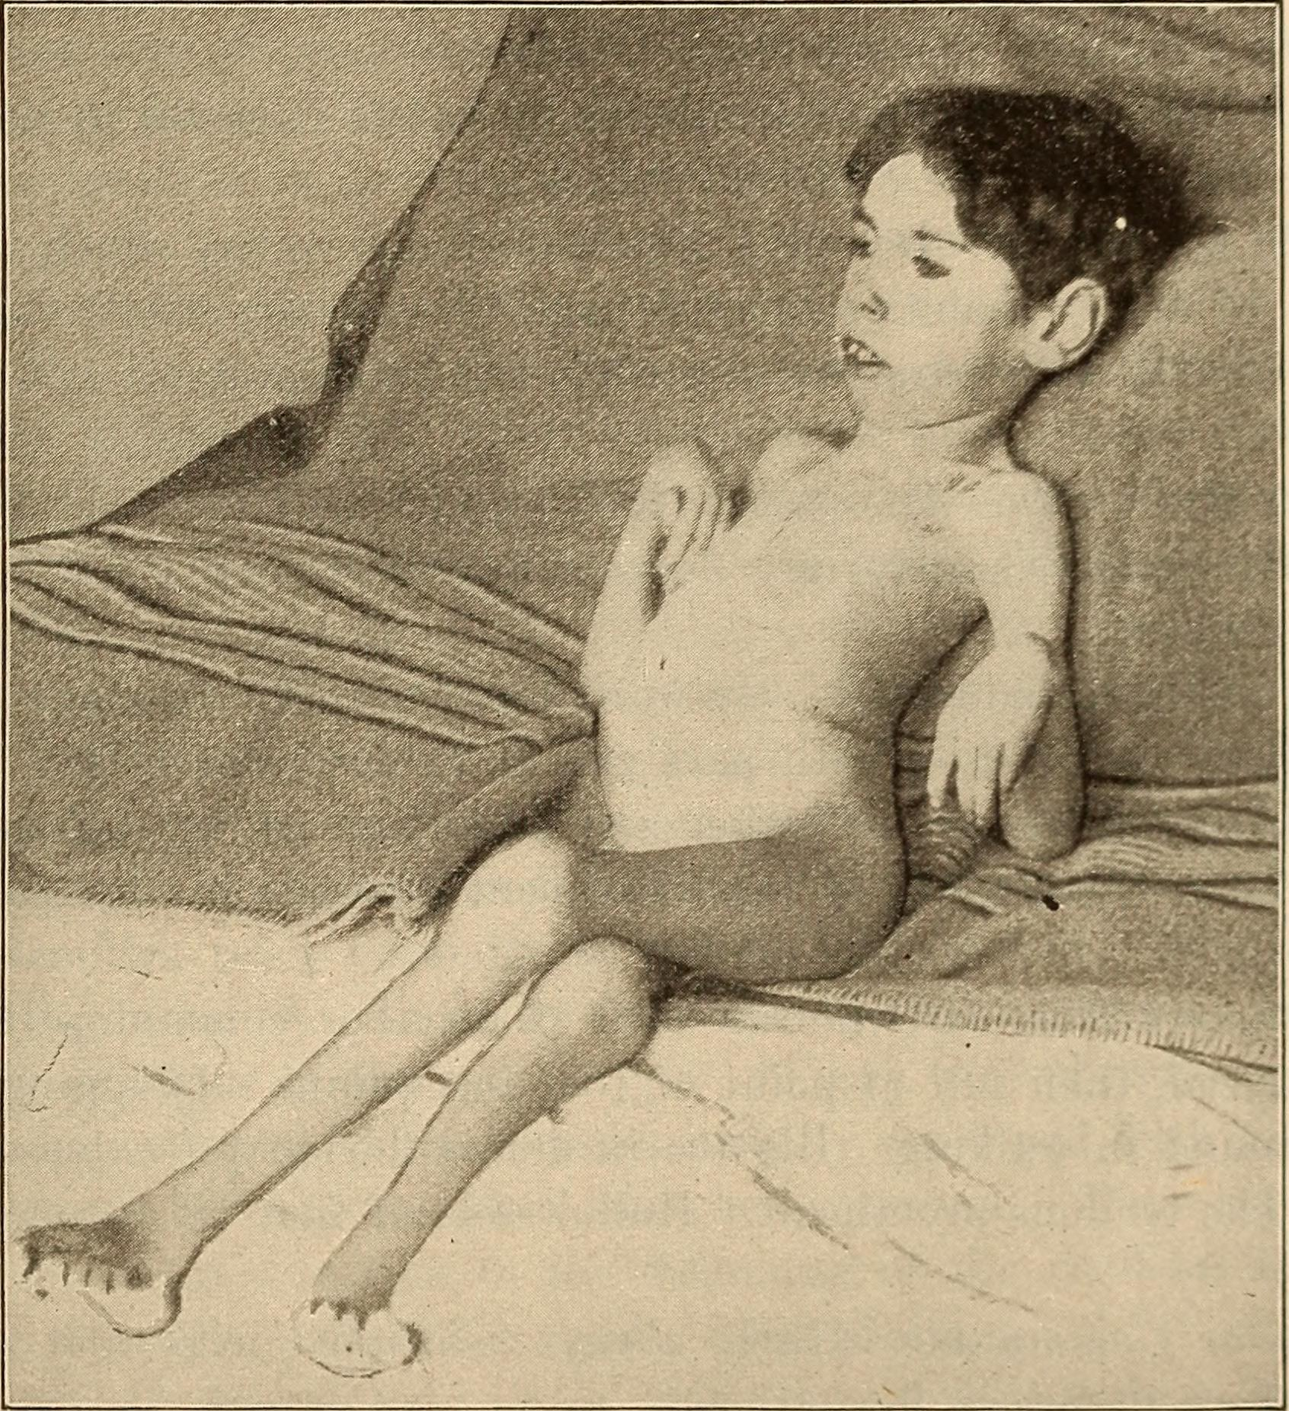

Slide 31
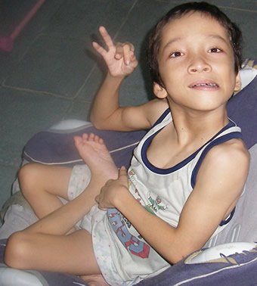
Cerebral Palsy

Slide 32
DIAGNOSIS
Mostly Clinical
Careful History & Examination
Any infant with delayed Motor Development must be suspected a case of CP
Diagnosis is difficult before 6 months of age
Clinical picture is only evident when cerebral cortex matures

Slide 33
One should be highly suspicious of presence of CP if there is motor delay but evidence of normal cognitive developments
To locate the structural lesions or associated congenital anomalies, EEG or CT Scan may be helpful
CP may be associated with Hearing or Visual Impairment, tests of Hearing & Vision are important

Slide 34
DIFFERENTIAL DIAGNOSIS
Leukodystrophy
Hydrocephalus / Subdural Effusion
Brain Tumor
Spinal Cord Lesions
Muscular Dystrophy
Progressive CNS Disorders
The presence of more than one child with motor deficit in the same family should always alert the physician to the likelihood of a disease other than CP

Slide 35
TREATMENT
The aim of treating the physical disability is to improve function & to prevent secondary complications of the musculo-skeletal system
1) Treatment of child with Cerebral Palsy consists of;
  Physical & Occupational therapy
  Control of Seizures
  Stretching Exercise
  Surgical Procedures of to Prevent Contractures

Slide 36
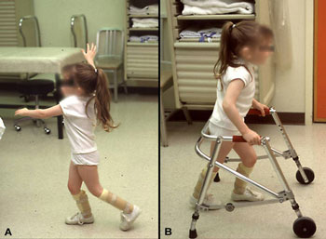

Slide 37
TREATMENT
2) Parents should be taught how to handle their child in daily activities
3) Family support is essential for emotional growth to manage the child
4) Exercises are advised to prevent the contractures
5) Tight Achilles tendon is a common problem & in case of contracture, Surgical Treatment is required

Slide 38
6) Diazepam, Baclofen & Dantrolene may reduce spasticity but drowsiness & lethargy & poor handling of salivary secretions are the limiting factors
7) Patients with Athetosis may get benefit by using Levodopa
8) Children with Dystonia may respond to Carbamazepine
9) Hearing, Vision, Learning & Mental disorders are accordingly managed

Slide 39
PREVENTION
Prevention of Cerebral Palsy can be accomplished by;
  Prevention of Kernicterus
  Meticulous care of Low Birth Weight Infants
  Prompt therapy of Apnic Episodes

Slide 40
PROGNOSIS
Depends on the;
  Extent of Disability
  Type & Intensity of Rehabilitation efforts
Physical & Intellectual abilities are the primary determinants of Functional Potential.

Slide 41


